Slide 1

Networking Lab (Final)
Assignment
Prepared by:
Antor Hawlader
ID: 222071024
Dept: CSE
Batch: 30th
8th Semester
Submitted to:
Dr. Md. Rabiul Islam, Professor,
Department of CSE & CSIT SMUCT
Shanto Mariam University of Creative Technology
Department: CSE
CSE-3286: Networking Lab [A]

Slide 2
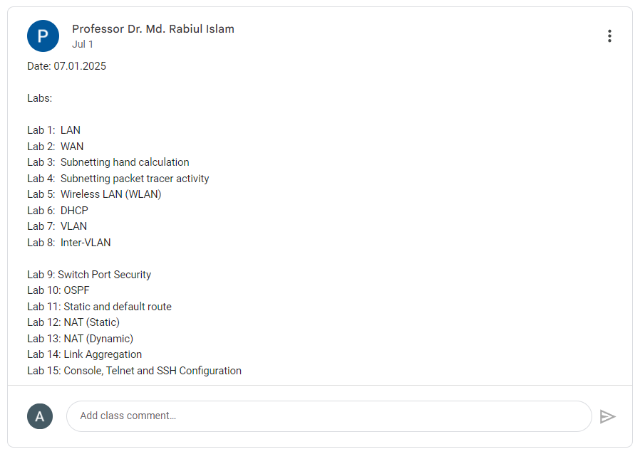

Slide 3
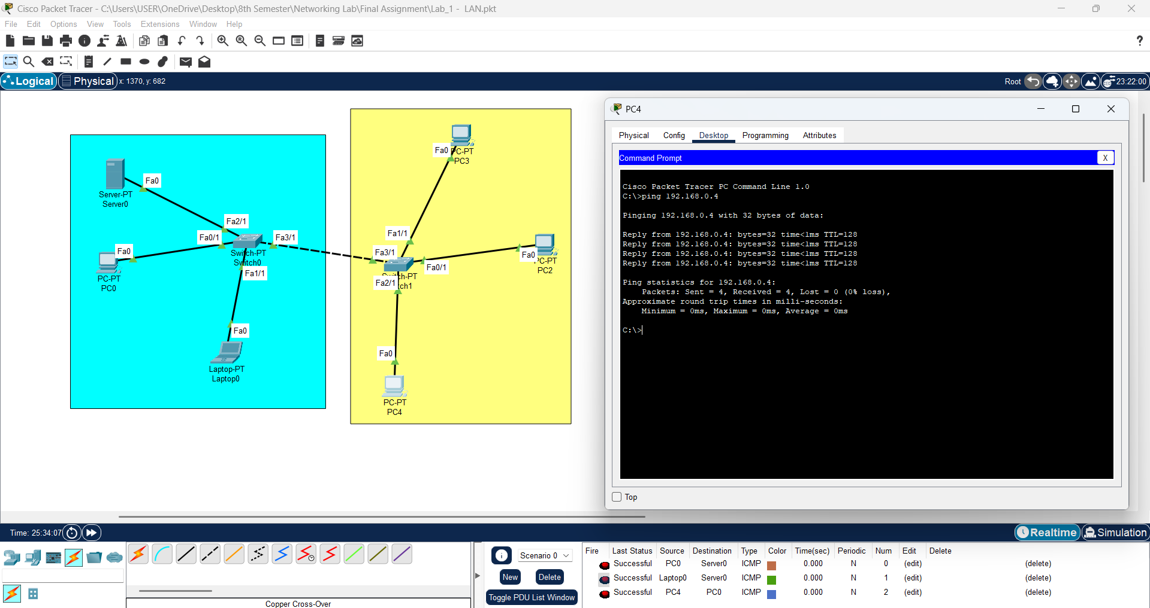
Lab 1 - LAN

Slide 4
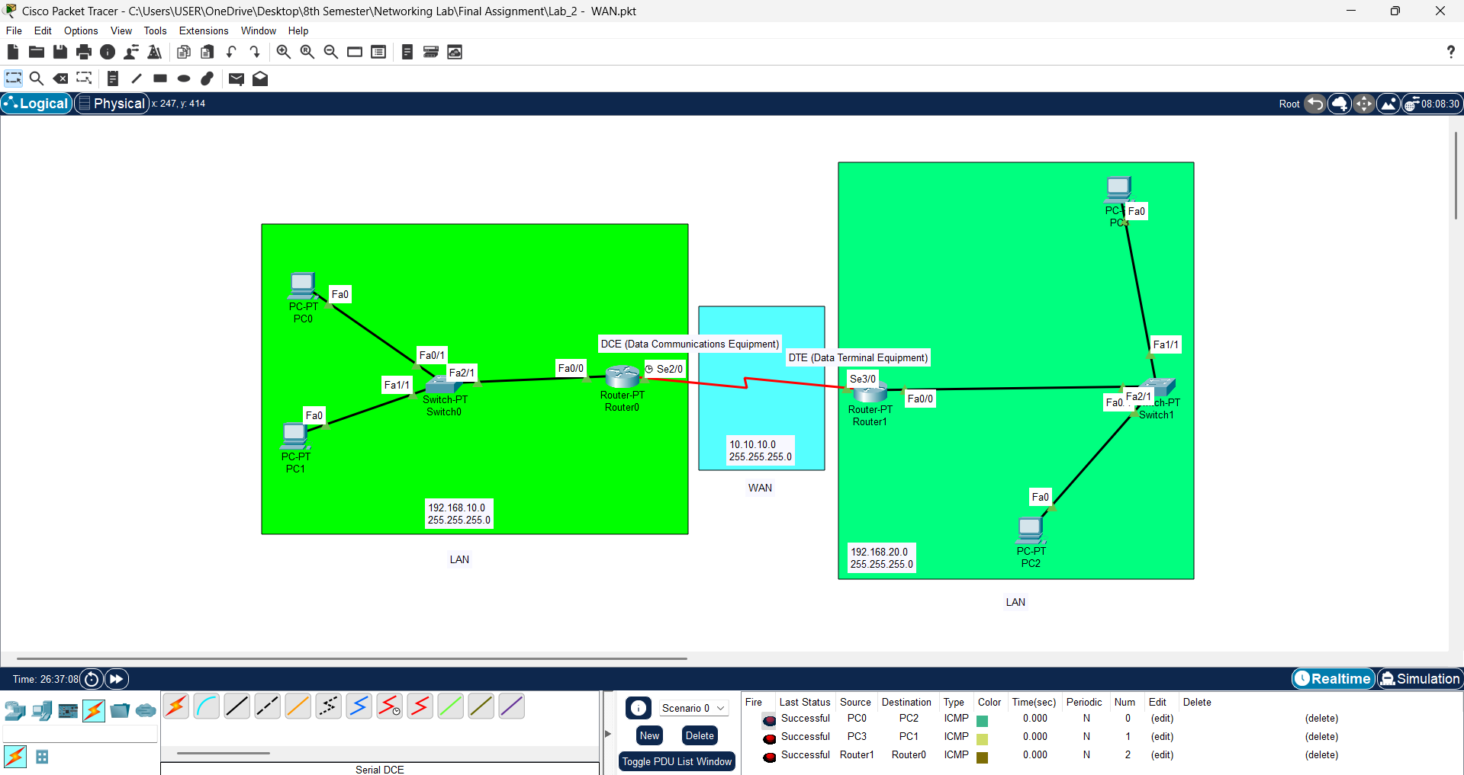
Lab 2 - WAN

Slide 5
Router0
Router1
Router Configuration
Router Configuration
Router>enable
Router#configure terminal
Router(config)#interface fa0/0
Router(config-if)#ip address 192.168.10.1 255.255.255.0
Router(config-if)#no shutdown
Router>enable
Router#configure terminal
Router(config)#interface fa0/0
Router(config-if)#ip address 192.168.20.1 255.255.255.0
Router(config-if)#no shutdown
Router Configuration (Serial)
Router Configuration (Serial)
Router>enable
Router#configure terminal
Router(config)#interface se2/0
Router(config-if)#ip address 10.10.10.1 255.255.255.0
Router(config-if)#clock rate 64000
Router(config-if)#no shutdown
Router>enable
Router#configure terminal
Router(config)#interface se3/0
Router(config-if)#ip address 10.10.10.2 255.255.255.0
Router(config-if)#no shutdown
Serial DCE
IP Route Configuration (Router0)
IP Route Configuration (Router1)
Router>enable
Router#configure terminal
Router(config)#ip route 192.168.20.0 255.255.255.0 se2/0
Router>enable
Router#configure terminal
Router(config)#ip route 192.168.10.0 255.255.255.0 se3/0
More
Router>enable
Router#show ip route
Router#show running-config
Router#show startup-config
Router#copy running-config startup-config

Slide 6
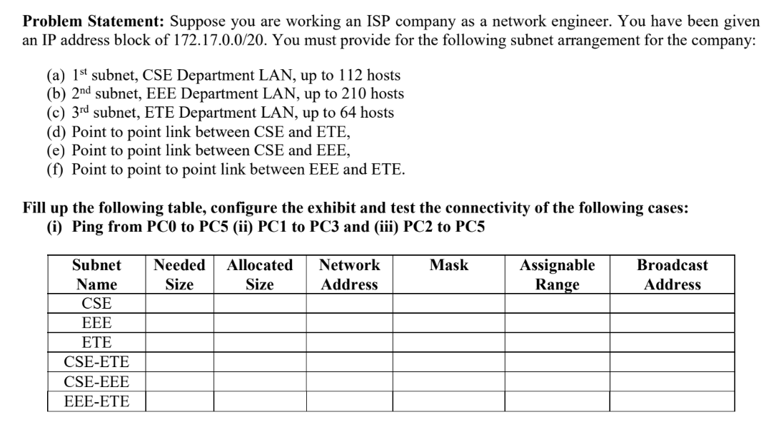
Lab 3 - Subnetting hand calculation
CIDR | Subnet Mask | Hosts (Usable)
/1 | 128.0.0.0 | 2,147,483,646
/2 | 192.0.0.0 | 1,073,741,822
/3 | 224.0.0.0 | 536,870,910
/4 | 240.0.0.0 | 268,435,454
/5 | 248.0.0.0 | 134,217,726
/6 | 252.0.0.0 | 67,108,862
/7 | 254.0.0.0 | 33,554,430
/8 | 255.0.0.0 | 16,777,214
/9 | 255.128.0.0 | 8,388,606
/10 | 255.192.0.0 | 4,194,302
/11 | 255.224.0.0 | 2,097,150
/12 | 255.240.0.0 | 1,048,574
/13 | 255.248.0.0 | 524,286
/14 | 255.252.0.0 | 262,142
/15 | 255.254.0.0 | 131,070
/16 | 255.255.0.0 | 65,534
/17 | 255.255.128.0 | 32,766
/18 | 255.255.192.0 | 16,382
/19 | 255.255.224.0 | 8,190
/20 | 255.255.240.0 | 4,094
/21 | 255.255.248.0 | 2,046
/22 | 255.255.252.0 | 1,022
/23 | 255.255.254.0 | 510
/24 | 255.255.255.0 | 254
/25 | 255.255.255.128 | 126
/26 | 255.255.255.192 | 62
/27 | 255.255.255.224 | 30
/28 | 255.255.255.240 | 14
/29 | 255.255.255.248 | 6
/30 | 255.255.255.252 | 2
/31 | 255.255.255.254 | 0*
/32 | 255.255.255.255 | 0

Slide 7
Solution of the problem: 172.17.0.0 / 20
Step 1: Sort (Descending order) the number of subnets according to their requirement
1st -- subnet, EEE Department LAN => 210 + 2 = 212 - (2⁸) /24
2nd -- subnet, CSE Department LAN => 112 + 2 = 114 - (2⁷) /25
3rd -- subnet, ETE Department LAN => 64 + 2 = 66 - (2⁷) /25
Step 2: Step 3: 212 <= 2^{N}
4th -- Point to point link between CSE and ETE => 2 + 2 = 4 - (2²) /30
5th -- Point to point link between CSE and EEE => 2 + 2 = 4 - (2²) /30
6th -- Point to point link between EEE and ETE => 2 + 2 = 4 - (2²) /30
128 | 64 | 32 | 16 | 8 | 4 | 2 | 1 | 128 | 64 | 32 | 16 | 8 | 4 | 2 | 1 | 128 | 64 | 32 | 16 | 8 | 4 | 2 | 1 | 128 | 64 | 32 | 16 | 8 | 4 | 2 | 1
1 | 0 | 1 | 0 | 1 | 1 | 0 | 0 | 0 | 0 | 0 | 1 | 0 | 0 | 0 | 1 | 0 | 0 | 0 | 0 | 0 | 0 | 0 | 0 | 0 | 0 | 0 | 0 | 0 | 0 | 0 | 0 | Network EEE | 172.17.0.0 / 24
1 | 0 | 1 | 0 | 1 | 1 | 0 | 0 | 0 | 0 | 0 | 1 | 0 | 0 | 0 | 1 | 0 | 0 | 0 | 0 | 0 | 0 | 0 | 0 | 0 | 0 | 0 | 0 | 0 | 0 | 0 | 1 | 1st Host of EEE | 172.17.0.1 / 24
1 | 0 | 1 | 0 | 1 | 1 | 0 | 0 | 0 | 0 | 0 | 1 | 0 | 0 | 0 | 1 | 0 | 0 | 0 | 0 | 0 | 0 | 0 | 0 | 1 | 1 | 1 | 1 | 1 | 1 | 1 | 0 | Last Host of EEE | 172.17.0.254 / 24
1 | 0 | 1 | 0 | 1 | 1 | 0 | 0 | 0 | 0 | 0 | 1 | 0 | 0 | 0 | 1 | 0 | 0 | 0 | 0 | 0 | 0 | 0 | 0 | 1 | 1 | 1 | 1 | 1 | 1 | 1 | 1 | Broadcast EEE | 172.17.0.255 / 24
1 | 0 | 1 | 0 | 1 | 1 | 0 | 0 | 0 | 0 | 0 | 1 | 0 | 0 | 0 | 1 | 0 | 0 | 0 | 0 | 0 | 0 | 0 | 1 | 0 | 0 | 0 | 0 | 0 | 0 | 0 | 0 | Network CSE | 172.17.1.0 / 25
1 | 0 | 1 | 0 | 1 | 1 | 0 | 0 | 0 | 0 | 0 | 1 | 0 | 0 | 0 | 1 | 0 | 0 | 0 | 0 | 0 | 0 | 0 | 1 | 0 | 0 | 0 | 0 | 0 | 0 | 0 | 1 | 1st Host of CSE | 172.17.1.1 / 25
1 | 0 | 1 | 0 | 1 | 1 | 0 | 0 | 0 | 0 | 0 | 1 | 0 | 0 | 0 | 1 | 0 | 0 | 0 | 0 | 0 | 0 | 0 | 1 | 0 | 1 | 1 | 1 | 1 | 1 | 1 | 0 | Last Host of CSE | 172.17.1.126 / 25
1 | 0 | 1 | 0 | 1 | 1 | 0 | 0 | 0 | 0 | 0 | 1 | 0 | 0 | 0 | 1 | 0 | 0 | 0 | 0 | 0 | 0 | 0 | 1 | 0 | 1 | 1 | 1 | 1 | 1 | 1 | 1 | Broadcast CSE | 172.17.1.127 / 25
1 | 0 | 1 | 0 | 1 | 1 | 0 | 0 | 0 | 0 | 0 | 1 | 0 | 0 | 0 | 1 | 0 | 0 | 0 | 0 | 0 | 0 | 0 | 1 | 1 | 0 | 0 | 0 | 0 | 0 | 0 | 0 | Network ETE | 172.17.1.128 / 25
1 | 0 | 1 | 0 | 1 | 1 | 0 | 0 | 0 | 0 | 0 | 1 | 0 | 0 | 0 | 1 | 0 | 0 | 0 | 0 | 0 | 0 | 0 | 1 | 1 | 0 | 0 | 0 | 0 | 0 | 0 | 1 | 1st Host of ETE | 172.17.1.129 / 25
1 | 0 | 1 | 0 | 1 | 1 | 0 | 0 | 0 | 0 | 0 | 1 | 0 | 0 | 0 | 1 | 0 | 0 | 0 | 0 | 0 | 0 | 0 | 1 | 1 | 1 | 1 | 1 | 1 | 1 | 1 | 0 | Last Host of ETE | 172.17.1.254 / 25
1 | 0 | 1 | 0 | 1 | 1 | 0 | 0 | 0 | 0 | 0 | 1 | 0 | 0 | 0 | 1 | 0 | 0 | 0 | 0 | 0 | 0 | 0 | 1 | 1 | 1 | 1 | 1 | 1 | 1 | 1 | 1 | Broadcast ETE | 172.17.1.255 / 25
1 | 0 | 1 | 0 | 1 | 1 | 0 | 0 | 0 | 0 | 0 | 1 | 0 | 0 | 0 | 1 | 0 | 0 | 0 | 0 | 0 | 0 | 1 | 0 | 0 | 0 | 0 | 0 | 0 | 0 | 0 | 0 | Network CSE-ETE | 172.17.2.0 / 30
1 | 0 | 1 | 0 | 1 | 1 | 0 | 0 | 0 | 0 | 0 | 1 | 0 | 0 | 0 | 1 | 0 | 0 | 0 | 0 | 0 | 0 | 1 | 0 | 0 | 0 | 0 | 0 | 0 | 0 | 0 | 1 | 1st Host of CSE-ETE | 172.17.2.1 / 30
1 | 0 | 1 | 0 | 1 | 1 | 0 | 0 | 0 | 0 | 0 | 1 | 0 | 0 | 0 | 1 | 0 | 0 | 0 | 0 | 0 | 0 | 1 | 0 | 0 | 0 | 0 | 0 | 0 | 0 | 1 | 0 | Last Host of CSE-ETE | 172.17.2.2 / 30
1 | 0 | 1 | 0 | 1 | 1 | 0 | 0 | 0 | 0 | 0 | 1 | 0 | 0 | 0 | 1 | 0 | 0 | 0 | 0 | 0 | 0 | 1 | 0 | 0 | 0 | 0 | 0 | 0 | 0 | 1 | 1 | Broadcast CSE-ETE | 172.17.2.3 / 30
1 | 0 | 1 | 0 | 1 | 1 | 0 | 0 | 0 | 0 | 0 | 1 | 0 | 0 | 0 | 1 | 0 | 0 | 0 | 0 | 0 | 0 | 1 | 0 | 0 | 0 | 0 | 0 | 0 | 1 | 0 | 0 | Network CSE-EEE | 172.17.2.4 / 30
1 | 0 | 1 | 0 | 1 | 1 | 0 | 0 | 0 | 0 | 0 | 1 | 0 | 0 | 0 | 1 | 0 | 0 | 0 | 0 | 0 | 0 | 1 | 0 | 0 | 0 | 0 | 0 | 0 | 1 | 0 | 1 | 1st Host of CSE-EEE | 172.17.2.5 / 30
1 | 0 | 1 | 0 | 1 | 1 | 0 | 0 | 0 | 0 | 0 | 1 | 0 | 0 | 0 | 1 | 0 | 0 | 0 | 0 | 0 | 0 | 1 | 0 | 0 | 0 | 0 | 0 | 0 | 1 | 1 | 0 | Last Host of CSE-EEE | 172.17.2.6 / 30
1 | 0 | 1 | 0 | 1 | 1 | 0 | 0 | 0 | 0 | 0 | 1 | 0 | 0 | 0 | 1 | 0 | 0 | 0 | 0 | 0 | 0 | 1 | 0 | 0 | 0 | 0 | 0 | 0 | 1 | 1 | 1 | Broadcast CSE-EEE | 172.17.2.7 / 30
1 | 0 | 1 | 0 | 1 | 1 | 0 | 0 | 0 | 0 | 0 | 1 | 0 | 0 | 0 | 1 | 0 | 0 | 0 | 0 | 0 | 0 | 1 | 0 | 0 | 0 | 0 | 0 | 1 | 0 | 0 | 0 | Network EEE-ETE | 172.17.2.8 / 30
1 | 0 | 1 | 0 | 1 | 1 | 0 | 0 | 0 | 0 | 0 | 1 | 0 | 0 | 0 | 1 | 0 | 0 | 0 | 0 | 0 | 0 | 1 | 0 | 0 | 0 | 0 | 0 | 1 | 0 | 0 | 1 | 1st Host of EEE-ETE | 172.17.2.9 / 30
1 | 0 | 1 | 0 | 1 | 1 | 0 | 0 | 0 | 0 | 0 | 1 | 0 | 0 | 0 | 1 | 0 | 0 | 0 | 0 | 0 | 0 | 1 | 0 | 0 | 0 | 0 | 0 | 1 | 0 | 1 | 0 | Last Host of EEE-ETE | 172.17.2.10 / 30
1 | 0 | 1 | 0 | 1 | 1 | 0 | 0 | 0 | 0 | 0 | 1 | 0 | 0 | 0 | 1 | 0 | 0 | 0 | 0 | 0 | 0 | 1 | 0 | 0 | 0 | 0 | 0 | 1 | 0 | 1 | 1 | Broadcast EEE-ETE | 172.17.2.11 / 30

Slide 8
Subnet Name | Needed Size | Allocated Size | Network Address | Mask | Assignable Range | Broadcast Address
EEE | 210 | 254 | 172.17.0.0 / 24 | 255.255.255.0 | 172.17.0.1 - 172.17.0.254 | 172.17.0.255
CSE | 112 | 126 | 172.17.1.0 / 25 | 255.255.255.128 | 172.17.1.1 - 172.17.1.126 | 172.17.1.127
ETE | 64 | 126 | 172.17.1.128 / 25 | 255.255.255.128 | 172.17.1.129 - 172.17.1.254 | 172.17.1.255
CSE-ETE | 2 | 2 | 172.17.2.0 / 30 | 255.255.255.252 | 172.17.2.1 - 172.17.2.2 | 172.17.2.3
CSE-EEE | 2 | 2 | 172.17.2.4 / 30 | 255.255.255.252 | 172.17.2.5 - 172.17.2.6 | 172.17.2.7
EEE-ETE | 2 | 2 | 172.17.2.8 / 30 | 255.255.255.252 | 172.17.2.9 - 172.17.2.10 | 172.17.2.11

Slide 9
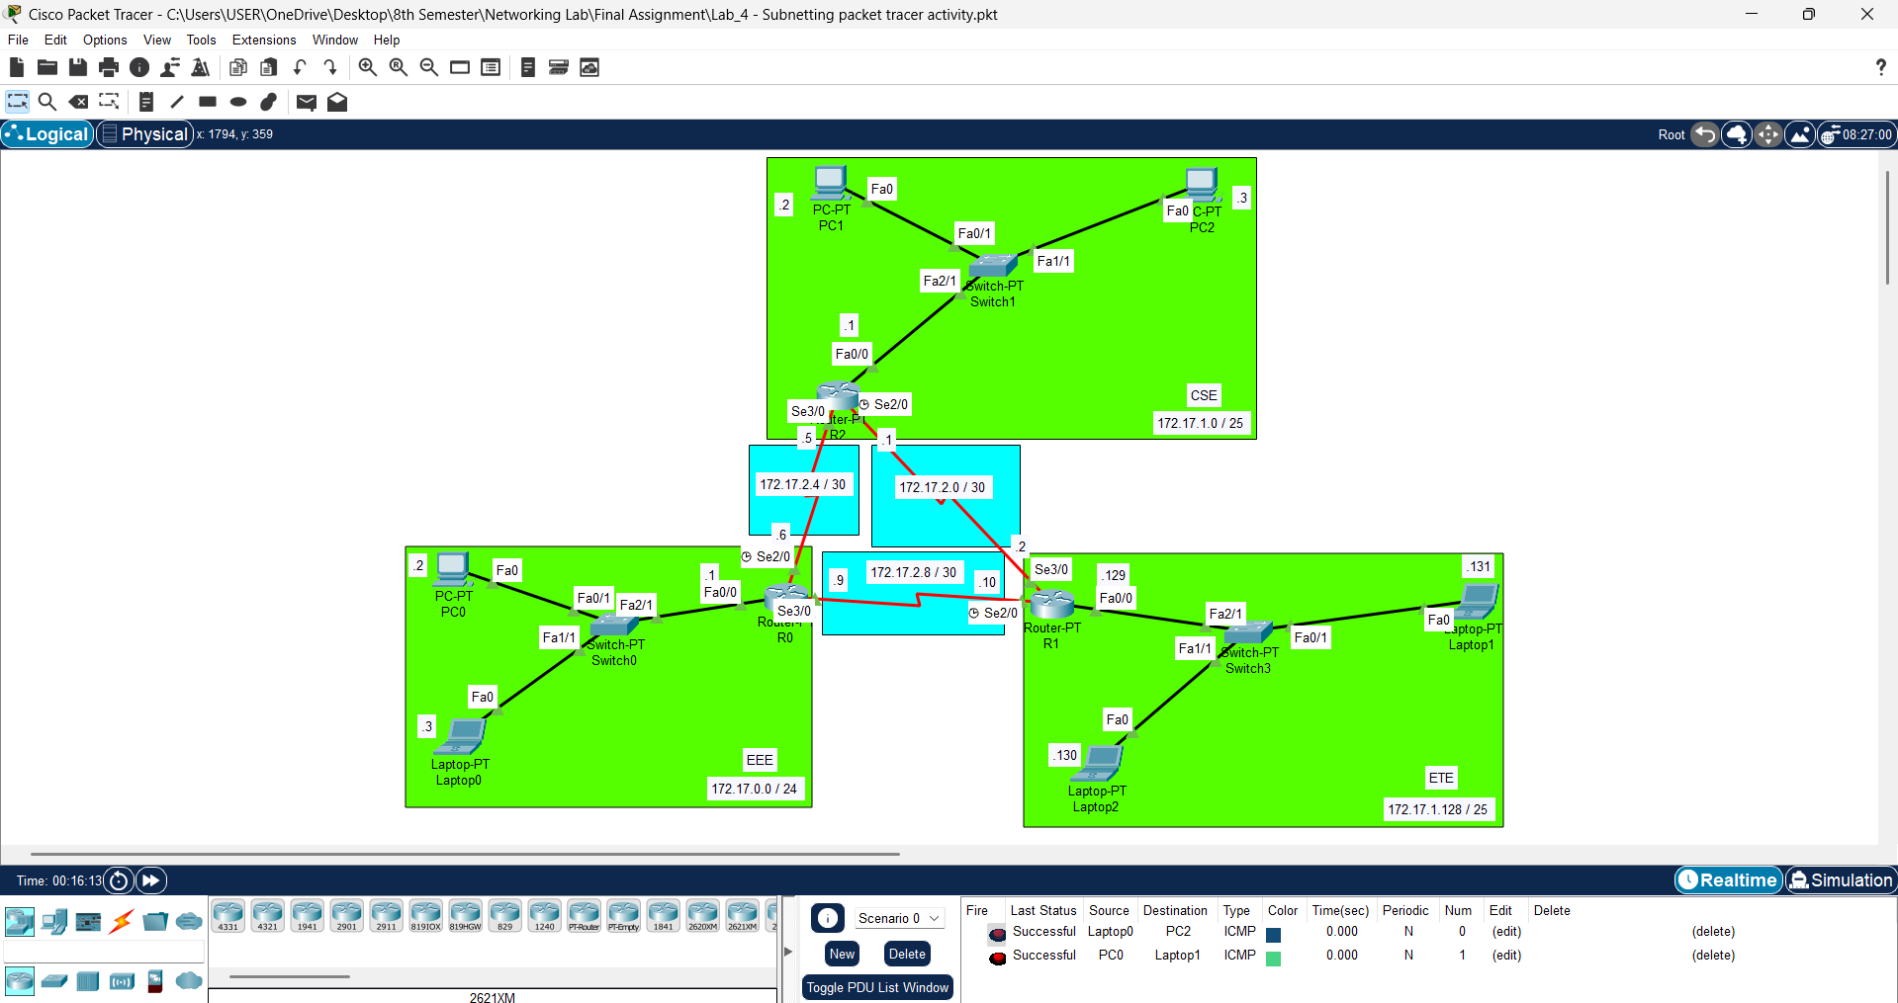
Lab 4 - Subnetting packet tracer activity

Slide 10
Router-PT R0 (EEE)
Router-PT R2 (CSE)
Router-PT R1 (ETE)
Router Configuration
Router Configuration
Router Configuration
Router>enable
Router#configure terminal
Router(config)#interface fa0/0
Router(config-if)#ip address 172.17.0.1 255.255.255.0
Router(config-if)#no shutdown
Router>enable
Router#configure terminal
Router(config)#interface fa0/0
Router(config-if)#ip address 172.17.1.1 255.255.255.0
Router(config-if)#no shutdown
Router>enable
Router#configure terminal
Router(config)#interface fa0/0
Router(config-if)#ip address 172.17.1.129 255.255.255.0
Router(config-if)#no shutdown
Router Configuration (Serial se2/0)
Router Configuration (Serial se2/0)
Router Configuration (Serial se2/0)
Router(config)#interface se2/0
Router(config-if)#ip address 172.17.2.6 255.255.255.252
Router(config-if)#clock rate 64000
Router(config-if)#no shutdown
Router(config-if)#exit
Router(config)#interface se2/0
Router(config-if)#ip address 172.17.2.1 255.255.255.252
Router(config-if)#clock rate 64000
Router(config-if)#no shutdown
Router(config-if)#exit
Router(config)#interface se2/0
Router(config-if)#ip address 172.17.2.10 255.255.255.252
Router(config-if)#clock rate 64000
Router(config-if)#no shutdown
Router(config-if)#exit
Serial DCE
Serial DCE
Serial DCE
Router Configuration (Serial se3/0)
Router Configuration (Serial se3/0)
Router Configuration (Serial se3/0)
Router(config)#interface se3/0
Router(config-if)#ip address 172.17.2.9 255.255.255.252
Router(config-if)#no shutdown
Router(config)#interface se3/0
Router(config-if)#ip address 172.17.2.5 255.255.255.252
Router(config-if)#no shutdown
Router(config)#interface se3/0
Router(config-if)#ip address 172.17.2.2 255.255.255.252
Router(config-if)#no shutdown
IP Route Configuration
IP Route Configuration
IP Route Configuration
Router(config)#ip route 172.17.1.0 255.255.255.128 se2/0
Router(config)#ip route 172.17.1.128 255.255.255.128 se3/0
Router(config)#ip route 172.17.0.0 255.255.255.0 se2/0
Router(config)#ip route 172.17.1.128 255.255.255.128 se3/0
Router(config)#ip route 172.17.0.0 255.255.255.0 se2/0
Router(config)#ip route 172.17.1.0 255.255.255.128 se3/0

Slide 11
Lab 5 - Wireless LAN (WLAN)

Slide 12
Lab 6 - DHCP

Slide 13
Lab 7 - VLAN

Slide 14
Lab 8 - Inter-VLAN

Slide 15
Lab 9 - Switch Port Security

Slide 16
Lab 10 - OSPF

Slide 17
Lab 11 - Static and default route

Slide 18
Lab 12 - NAT (Static)

Slide 19
Lab 13 - NAT (Dynamic)

Slide 20
Lab 14 - Link Aggregation

Slide 21
Lab 15 - Console, Telnet and SSH Configuration

